Slide 1
Lexical SD based on proximity
Lecture 7

Slide 2
Outline
Periphrasis
Euphemism
Hyperbole
Understatement

Slide 3
Periphrasis
Periphrasis is derived from the Greek language, the word “peri” means ‘around’ and phrazein means “declare”.
Periphrasis is a SD which denotes the process of renaming
Periphrasis is describing the object instead of naming it.
Lake country = England
The Lord; Almighty; Goodness; Heavens; the Skies = God
a shield-bearer = a soldier
a play of swords = a battle

Slide 5
Logical
Figurative
Logical - based on inherent properties of a thing
Ex.: instrument of destruction nuclear bomb
Figurative - based on imagery: metaphor, metonymy.
Ex.: to tie a knot = to get married,
in disgrace of fortune = bad luck.

Slide 6
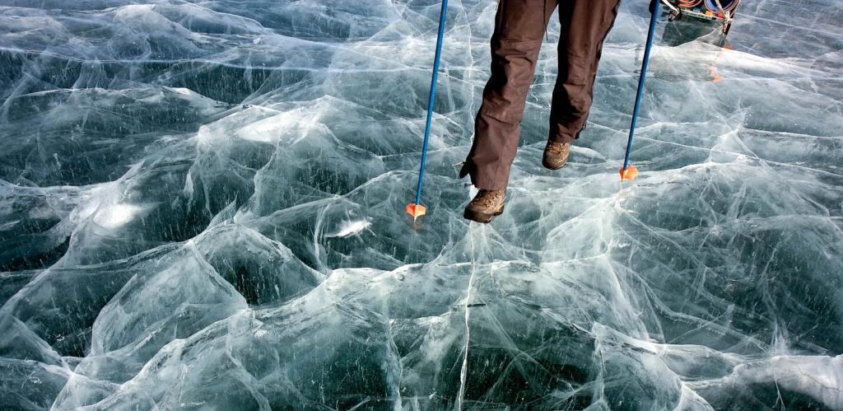
Periphrasis is metaphorical if based on similarity of concepts. Ex.: Diana felt suddenly that she was on very thin ice.

Slide 7
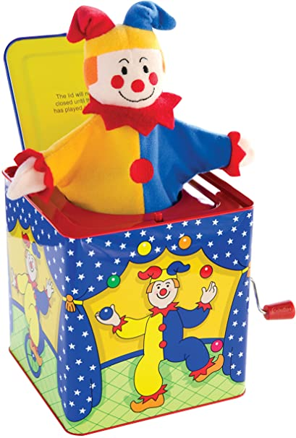
Periphrasis is metonymical if based on associative relations between the two concepts.
Ex.: The content of the bed sat up like a jack-in- the-box and said: “Who is that?”

Slide 8
Euphemisms
The term “euphemism” from Greek “eu” – “well”, “phemi” – “I am speaking”
It has been used to denote a definite stylistic device for many centuries.
A euphemism is a polite expression used in place of words or phrases that might otherwise be considered harsh or unpleasant.
to put an animal to sleep =to kill it because it is ill,
correctional institution = prison

Slide 9
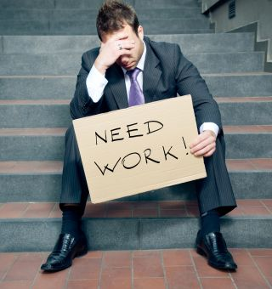
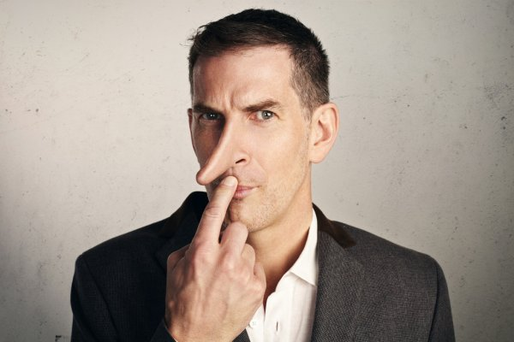
He is between jobs.
He is economical with the truth.

Slide 10
Euphemisms may be divided into several groups according to their spheres of application.
The most recognized are the following:
religious
moral
medical
parliamentary
Political euphemisms are found in newspaper language
free of job = unemployed
The life of euphemisms is short.

Slide 11
The oldest kind of euphemism is religious name of the God and some dark forces: the Lord (the God), old Nick/Gentleman (devil), the Old Gentleman (devil).
Thus, the verb to die may be replaced by euphemisms like to expire, to be no more, to join the majority, to be done, to depart, to go East and the more facetious ones, ex.: to kick the bucket, to give up the ghost

Slide 12
Hyperbole
Hyperbole, from a Greek word meaning “excess,” is a figure of speech that uses extreme exaggeration to make a point or show emphasis.
Many people use hyperbole as a figure of speech to make something seem larger or more important than it actually is.
Hyperbole is an integral part of such SDs as simile, metaphor, irony
Hyperbole is often used to form phraseological.
I’ve told you to clean your room a million times!
I had a ton of homework.
to make a mountain out of a molehill
делать из мухи слона, преувеличивать

Slide 13
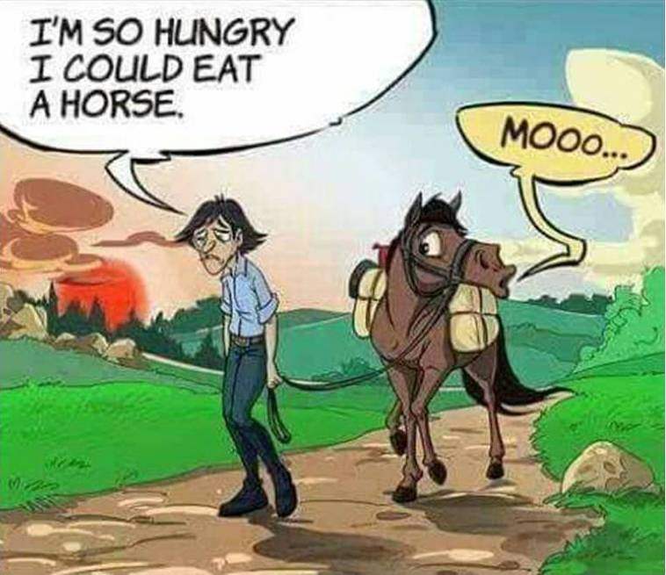
Hyperbole can create a humorous effect

Slide 14
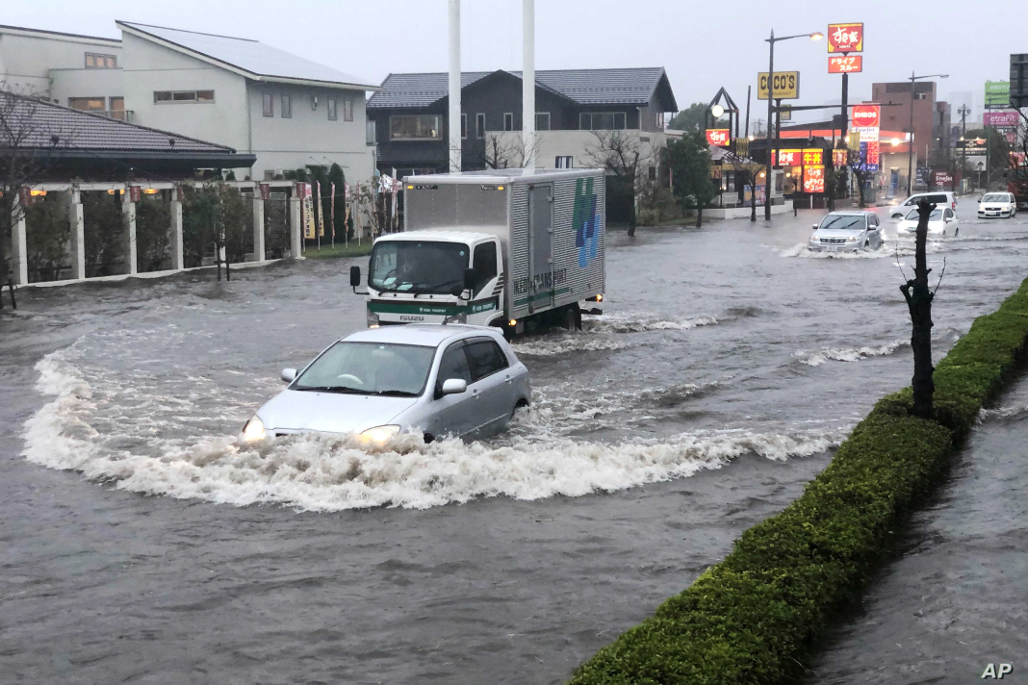
Understatement
Understatement is the reverse of exaggeration.
Understatement is a SD which consists in lessening, reducing the real quantity of the object.
An understatement usually has an ironic effect
It rained a bit more than usual.

Slide 15
The psychological essence of understatement is more complicated than that of hyperbole.
The hearer is expected to understand the intentional discrepancy between what the speaker says about the object and what he really thinks about it.
“I am rather annoyed” instead of “I’m infuriated’, “The wind is rather strong” instead of “There’s a gale blowing outside”

